Slide 1
Introduction to Operating System (OS)

Slide 2
What is an Operating System?
Computer System = Hardware + Software
Software = Application Software + System Software(OS)
An Operating System is a system Software that acts as an intermediary/interface between a user of a computer and the computer hardware.
Operating system goals:
Execute user programs and make solving user problems easier
Make the computer system convenient to use
Use the computer hardware in an efficient manner

Slide 3
Kernel
Kernel is a software code that reside in central core of OS. It has complete control over system.
When operation system boots, kernel is first part of OS to load in main memory.
Kernel remains in main memory for entire duration of computer session. The kernel code is usually loaded in to protected area of memory.
Kernel performs it’s task like executing processes and handling interrupts in kernel space.
User performs it’s task in user area of memory.
This memory separation is made in order to prevent user data and kernel data from interfering with each other.
Kernel does not interact directly with user, but it interacts using SHELL and other programs and hardware.

Slide 4
Kernel cont…
Kernel includes:-
1. Scheduler: It allocates the Kernel’s processing time to various processes.
2. Supervisor: It grants permission to use computer system resources to each process.
3. Interrupt handler : It handles all requests from the various hardware devices which compete for kernel services.
4. Memory manager : allocates space in memory for all users of kernel service.
kernel provides services for process management, file management, I/O management, memory management.
System calls are used to provide these type of services.

Slide 5
System Call
System call is the programmatic way in which a computer program/user application requests a service from the kernel of the operating system on which it is executed.
Application program is just a user-process. Due to security reasons , user applications are not given access to privileged resources(the ones controlled by OS).
When they need to do any I/O or have some more memory or spawn a process or wait for signal/interrupt, it requests operating system to facilitate all these. This request is made through System Call.
System calls are also called software-interrupts.

Slide 6
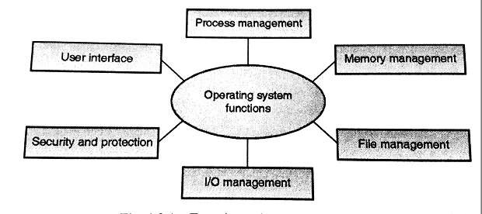
Functions of Operating System

Slide 7
1. Process Management
A process is a program in execution.
A process needs certain resources, including CPU time, memory, files, and I/O devices to accomplish its task.
Simultaneous execution leads to multiple processes. Hence creation, execution and termination of a process are the most basic functionality of an OS
If processes are dependent, than they may try to share same resources. thus task of process synchronization comes to the picture.
If processes are independent, than a due care needs to be taken to avoid their overlapping in memory area.
Based on priority, it is important to allow more important processes to execute first than others.

Slide 8
2. Memory management
Memory is a large array of words or bytes, each with its own address.
It is a repository of quickly accessible data shared by the CPU and I/O devices.
Main memory is a volatile storage device. When the computer made turn off everything stored in RAM will be erased automatically.
In addition to the physical RAM installed in your computer, most modern operating systems allow your computer to use a virtual memory system. Virtual memory allows your computer to use part of a permanent storage device (such as a hard disk) as extra memory.
The operating system is responsible for the following activities in connections with memory management:
Keep track of which parts of memory are currently being used and by whom.
Decide which processes to load when memory space becomes available.
Allocate and de-allocate memory space as needed.

Slide 9
3. File Management
A file is a collection of related information defined by its creator.
File systems provide the conventions for the encoding, storage and management of data on a storage device such as a hard disk.
FAT12 (floppy disks)
FAT16 (DOS and older versions of Windows)
FAT32 (older versions of Windows)
NTFS (newer versions of Windows)
EXT3 (Unix/Linux)
HFS+ (Max OS X)
The operating system is responsible for the following activities in connections with file management:
✦ File creation and deletion.
✦ Directory creation and deletion.
✦ Support of primitives for manipulating files and directories.
✦ Mapping files onto secondary storage.
✦ File backup on stable (nonvolatile) storage media.

Slide 10
4. Device Management or I/O Management
Device controllers are components on the motherboard (or on expansion cards) that act as an interface between the CPU and the actual device.
Device drivers, which are the operating system software components that interact with the devices controllers.
A special device (inside CPU) called the Interrupt Controller handles the task of receiving interrupt requests and prioritizes them to be forwarded to the processor.
Deadlocks can occur when two (or more) processes have control of different I/O resources that are needed by the other processes, and they are unwilling to give up control of the device.
It performs the following activities for device management.
Keeps tracks of all devices connected to system.
Designates a program responsible for every device known as Input/output controller.
Decides which process gets access to a certain device and for how long.
Allocates devices in an effective and efficient way.
Deallocates devices when they are no longer required.

Slide 11
History of Operating System
The First Generation (1940's to early 1950's)
No Operating System
All programming was done in absolute machine language, often by wiring up plug-boards to control the machine’s basic functions.
The Second Generation (1955-1965)
First operating system was introduced in the early 1950's.It was called GMOS
Created by General Motors for IBM's machine the 701.
Single-stream batch processing systems
The Third Generation (1965-1980)
Introduction of multiprogramming
Development of Minicomputer
The Fourth Generation (1980-Present Day)
Development of PCs
Birth of Windows/MaC OS

Slide 12
Types of Operating Systems
Batch Operating System
Multiprogramming Operating System
Time-Sharing OS
Multiprocessing OS
Distributed OS
Network OS
Real Time OS
Embedded OS

Slide 13
Popular types of OS
Desktop Class
Windows
OS X
Unix/Linux
Chrome OS
Server Class
Windows Server
Mac OS X Server
Unix/Linux
Mobile Class
Android
iOS
Windows Phone

Slide 14

Linux
Linux: An open-source, cross-platform operating system that runs on desktops, notebooks, tablets, and smartphones.
The name Linux is a combination Linus (the first name of the first developer) and UNIX (another operating system.
Users are free to modify the code, improve it, and redistribute it,
Developers are not allowed to charge money for the Linux kernel itself (the main part of the operating system), but they can charge money for distributions (distros for short).

Slide 15
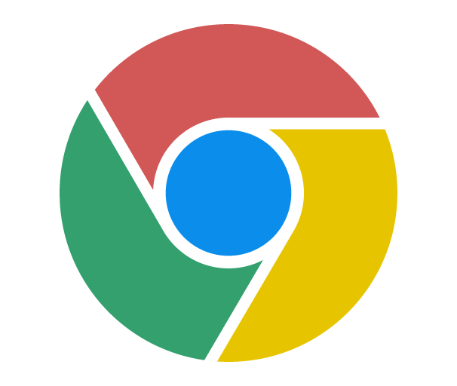
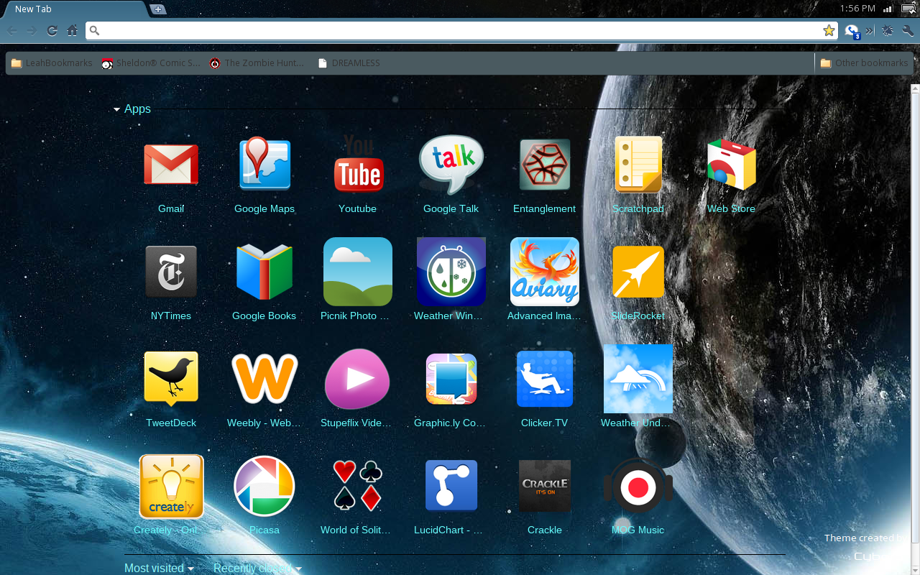
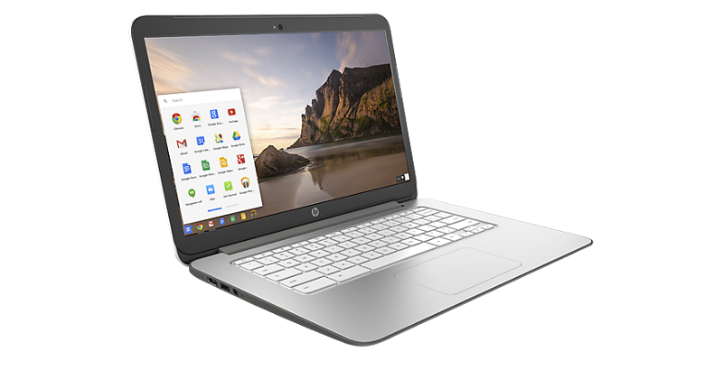
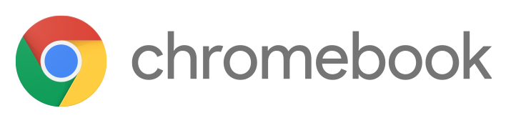
Google Chrome OS
Chrome OS. Is a popular thin client operating system.
Thin client A computer with minimal hardware, designed for a specific task. For example, a thin web client is designed for using the Internet.

Slide 16
Server Operating Systems
Windows Server
Familiar GUI interface for those experienced with Windows
UNIX
Very mature server capabilities, time-tested, large user community, stable
Linux
Free, customizable, many free services and utilities available

Slide 17
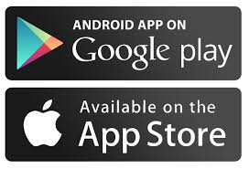
Tablet and Phone Operating Systems
System-on-chip (SoC): An operating system that comes preinstalled on a chip on a portable device such as a smartphone.
Popular SoC operating systems:
iOS: for iPad, iPhone
Android: for a variety of tablets and phones
Downloadable applications (apps) from an App store, for example:
Apple App Store
Google Play Store

